Slide 1
Testing
tl;dr testing is important and you will need to know how to do it, especially writing and using unit tests

Slide 2
Software Testing
Testing is very important for finding bugs and errors in code
And to verify correctness: does this application do what the customer wants?
Improve software quality
Improve reliability
Improve availability
Ease of use, user retention
Improve user experience
Reduce the risk of security issues (SQL injection, DoS, other vulnerabilities)

Slide 3
Testing can be very challenging
Developers make code to work, human nature makes it hard to test your own code thoroughly
Hard to test from the perspective of the end user
Hard to test in every possible environment the code will be deployed in
Code is very complicated
Not enough time/money may be allocated for testing
It's boring - it's much more fun to write code

Slide 4
Types of testing
http://en.wikipedia.org/wiki/Software_testing
Sanity testing
Continuous. Does the output/behavior seem plausible? For example, if your application returns -500 for a temperature or 2030 for a birth year, there's an error
Unit Testing
Does this particular component (function, class) work?
Integration testing
Do all of these components work together?
End to end (e2e)
Usually interact with the user interface
Compatibility testing
Does it work in different environments, with different versions of other applications it interfaces with?
System testing
Test all the things!

Slide 5
Types of testing
Alpha testing, Beta testing
Various degrees of almost-complete versions released to select clients/customers for feedback
Security testing
Can application handle malicious input and still function and protect data? For example, SQL injection, privilege elevation, bypass authentication?
User Experience (UX) testing
How do users like the product? Are they able to use it?
Fuzz testing
Automatically generate random invalid input. Useful for security testing, UX testing
Exhaustive testing (or more likely, bounded exhaustive testing)
Expensive, time consuming, often impractical. Applicable if you are writing software for a Mars rover, airplane control software, or for controlling a nuclear power plant
http://www.techwell.com/2013/06/how-exhaustive-testing-ensured-successful-voyage-mars-rover

Slide 6
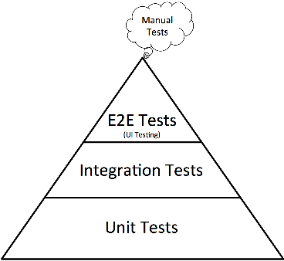
Testing Pyramids
Size of sector represents how much effort/how many tests for each type of test

Slide 7
Testing Ideals
Test as you develop, NOT at the end (Agile methodology stresses ongoing testing)
Test with valid and invalid input
Test with malicious input
Test with random input
Test everything every time anything is changed
Have a standard set of automatic tests; commonly configured to run on a schedule - daily, and/or as you push code to a repo* (with documentation of tests, which is updated as new tests are added)
Document results of testing, whether issue is fixed and how; typically through an issue tracker
Because if there's one instance of issue A, it's likely there's other parts of the code that are flawed in the same way
*See also: continuous integration, maybe cover later?

Slide 8
How do ideals compare with real life?
How much of this happens in real life?
Not enough of it… it's very time consuming
It's mathematically impossible to test every possible program state
Think of how many variables you have and how many possible values they have – exhaustively testing all possible combinations of all variables in a moderately sized program will take longer than the age of the universe

Slide 9
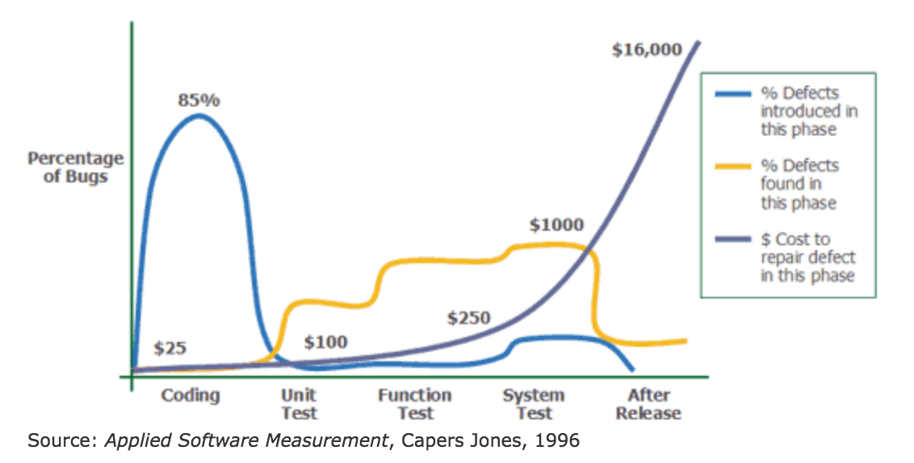
Cost of fixing bugs

Slide 10
Software Testing
Software testing is a skilled job
Testers need to understand the code and the end users; where the code will be deployed; be creative, possess a thorough knowledge of how to break code
Often companies will have Quality Assurance (QA) staff or testers who work independently from the developers
And have developers test their own, and other people's code

Slide 11
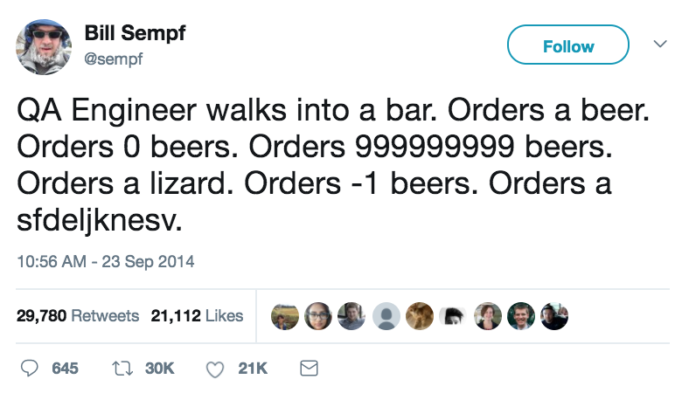
QA vs. automatic testing
Two broad types of testing
human tests (e.g. by you, or the QA staff, or later in the process, select customers, alpha/beta testers)
automated tests (e.g. unit tests such as Python's unittest tests)
Important to have both automatic tests, and human testers
https://www.sempf.net/post/On-Testing1

Slide 12
Even with thorough testing, errors still happen
Your job as a programmer is to anticipate errors, and deal with them as safely as possible
Consider things outside of your control – other systems your application communicates with; files; databases; user input
Take steps to recover, or terminate the program safely in even of fatal error
Exception handling is very useful

Slide 13
Handling Errors
General principles
Think about what parts of your code is likely to cause errors, and plan what to do if it errors
User input
DB
File IO
Network operations
Authentication
What else?
Handle errors (that you can do something about) as soon as is reasonably possible; before they will cause problems later
Example: if user types in wrong password, let them try again
If network is down, wait a short time and try again
If file is not found, ask user if they want to create it

Slide 14
Handling Errors - try and except
Add error handling to code that is likely to cause errors IF it's reasonable to recover from the error
If the program can't recover from the error,
Let it crash, logging any information known about the problem
Or close it as safely as possible (shut down open DB connections, save any data) logging any information known
The root cause will be discovered sooner
This type of error is often caused by syntax errors or buggy code, so seeing the errors makes it more likely the issue will be found and fixed

Slide 15
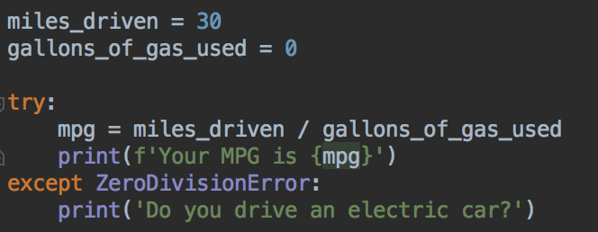
Handling Errors
Use the most specific type of Error in an except block
Only print (or display errors to the user) if the user can understand the message
Use logging for stack traces and other technical information

Slide 16
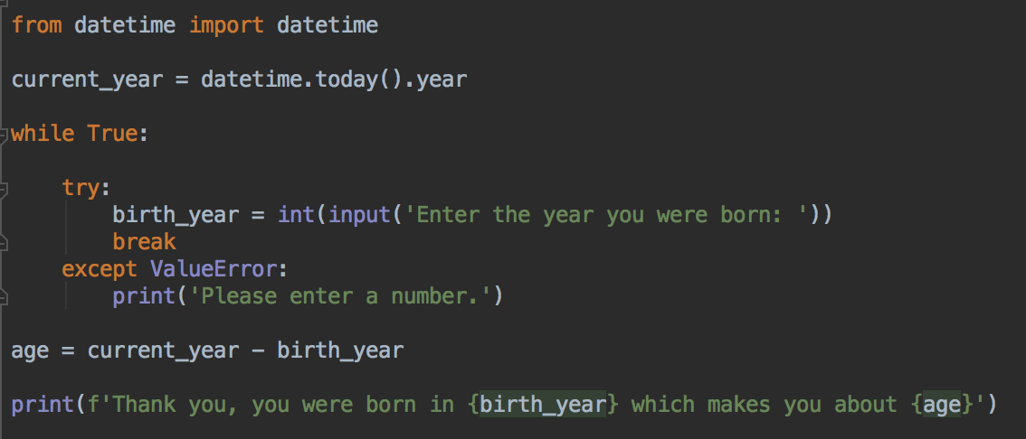
Error Checking and Handling
How can we modify this program so that it only accepts inputs between the current year, and 120 years ago?

Slide 17
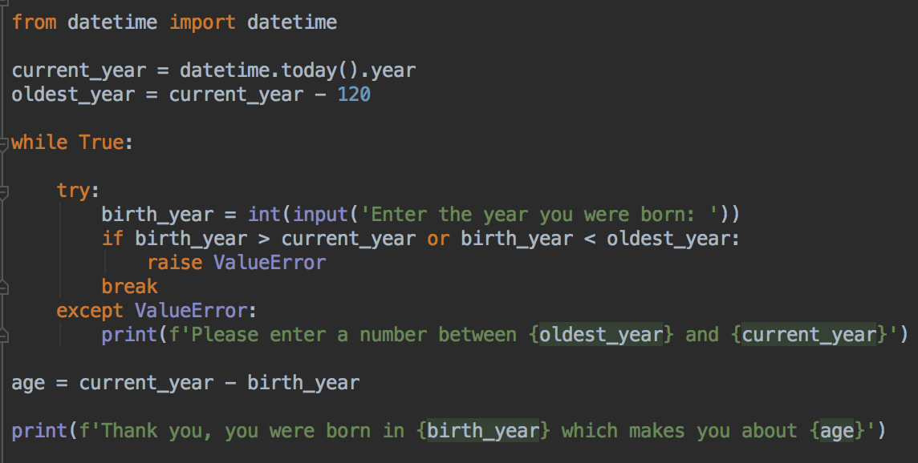
Raising Errors
Use the raise keyword

Slide 18
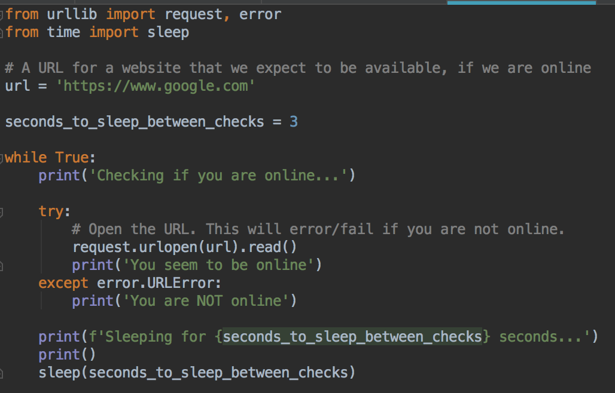
Exception Handling

Slide 19
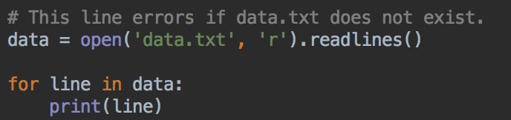
Error Handling
Type in this program, run and test
Sdd try except blocks so that the FileNotFoundError is caught if the data.txt file is not found
Print a file not found message in the except block

Slide 20
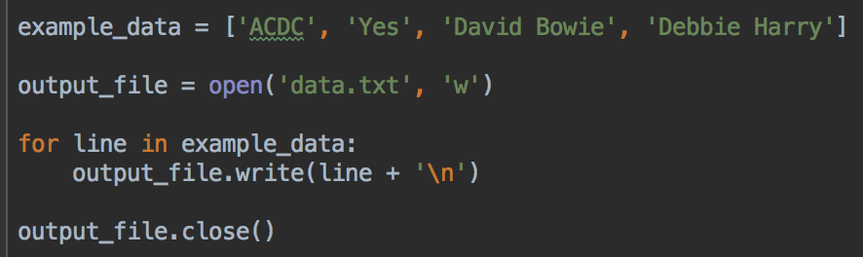
Files and other Resources
When writing to a file, it is important to close the file when done
Likewise, important to close connections to databases when done
If this program crashes before the file is closed, the file could remain open, data can be lost

Slide 21
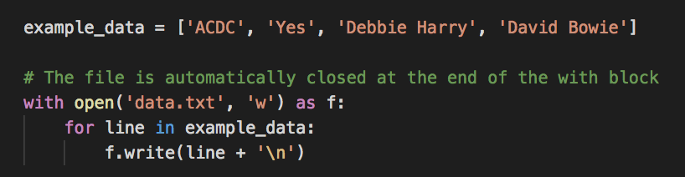
with - context manager
with is the python keyword for context manager
In this example, the file is automatically closed at the end of the with block
Does NOT handle exceptions - although the content manage will try to close the file if there is an error, your program will still crash
More examples when we look at databases

Slide 22
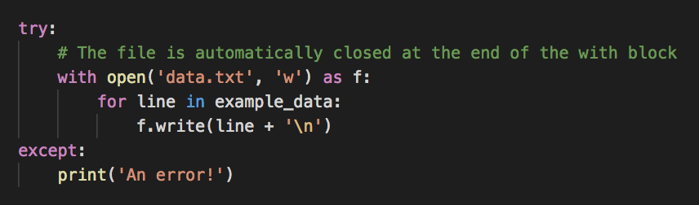
with - context manager plus exception handling
File is still closed automatically
You would obviously do something more useful in the except block :)

Slide 23
Exception Handling
OWASP secure coding standard has advice for error handling: https://www.owasp.org/images/0/08/OWASP_SCP_Quick_Reference_Guide_v2.pdf
How to handle exceptions, how not to handle exceptions
Mishandled, unhandled or suppressed exceptions cause code to crash, or not behave as expected, and cause other bugs
And, reveal information which can be used to exploit the code
In particular, don't let an exception crash your code
Don't reveal interesting information in error messages
For example, information on structure of a file system, or tables and columns in a database; stack traces
Many hacker exploits have arisen from interesting information gleaned from oversharing in error messages – links and examples at:
https://www.securecoding.cert.org/confluence/display/java/ERR01-J.+Do+not+allow+exceptions+to+expose+sensitive+information
http://cwe.mitre.org/data/definitions/209.html

Slide 24
Reading
Python library documentation on error handling
https://docs.python.org/3/tutorial/errors.html

Slide 25
Automatic Testing
Creating code that tests your code
Required reading:
http://www.drdobbs.com/testing/unit-testing-with-python/240165163
https://www.jeffknupp.com/blog/2013/12/09/improve-your-python-understanding-unit-testing/

Slide 26
Testing Frameworks
JUnit with Java http://junit.org/
C# and VB - The Microsoft Unit Testing Framework https://msdn.microsoft.com/en-us/library/hh694602.aspx
Android: JUnit Unit Tests and Instrumented tests
https://developer.android.com/training/testing/start/index.html
Unit testing in iOS development https://developer.apple.com/library/content/documentation/DeveloperTools/Conceptual/testing_with_xcode/chapters/04-writing_tests.html
Web: server unit tests in the server code's language
JavaScript: Jest, Mocha, Karma, Jasmine, QUnit, others http://developer.telerik.com/featured/journey-client-side-testing-javascript/
UX and browser testing: Selenium http://www.seleniumhq.org/
Many others

Slide 27
unittest
unittest is the standard library unit testing framework for Python code
https://docs.python.org/3.7/library/unittest.html
You can write a unit test to test a unit (usually one function or part of a function) of your Python code for correct functionality
Can have a set of unit tests for a project
Run tests as needed to verify code is still working, and that you haven't broken anything else

Slide 28
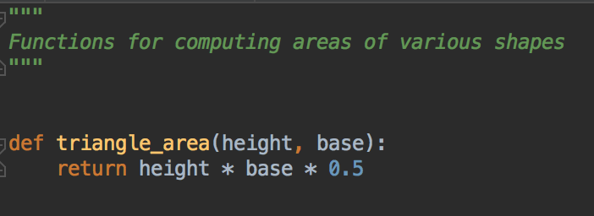
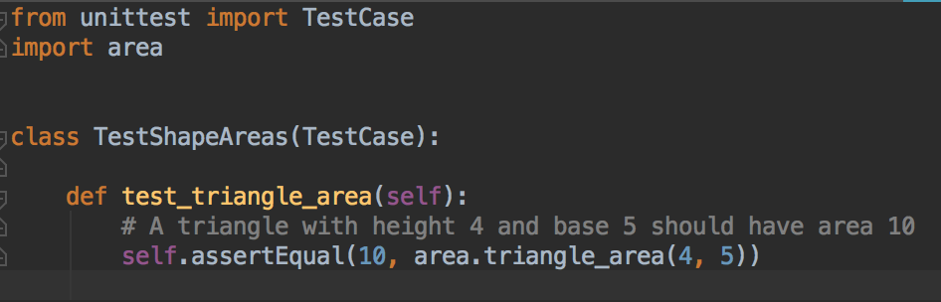
First Unit Test
Create two python files in the same directory, area.py and test_area.py
area.py
test_area.py

Slide 29
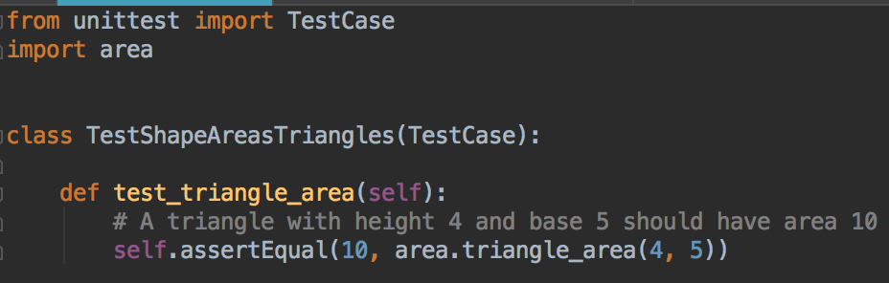
test_area.py
import test library and code to be tested
Create a class that's a subclass of unittest.TestCase
TestShapeAreaTriangles
Inside the class, create test methods
Method names must start with test....

Slide 30
Assertions
The heart of unit testing
Assert that your code is behaving correctly
In this example: assertEqual checks that the expected data is the same as the actual data produced by your code
The actual data created by the
program being tested - the return
value from the triangle_area() function
Expect to get 10
More assertion methods soon

Slide 31
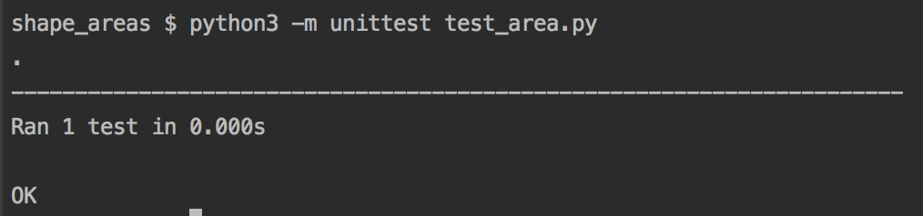
Run tests
From the command prompt or terminal, run your tests with one of these commands
Should see a message with the number of tests run, and an OK message
PC
python -m unittest test_area.py
Mac
python3 -m unittest test_area.py

Slide 32
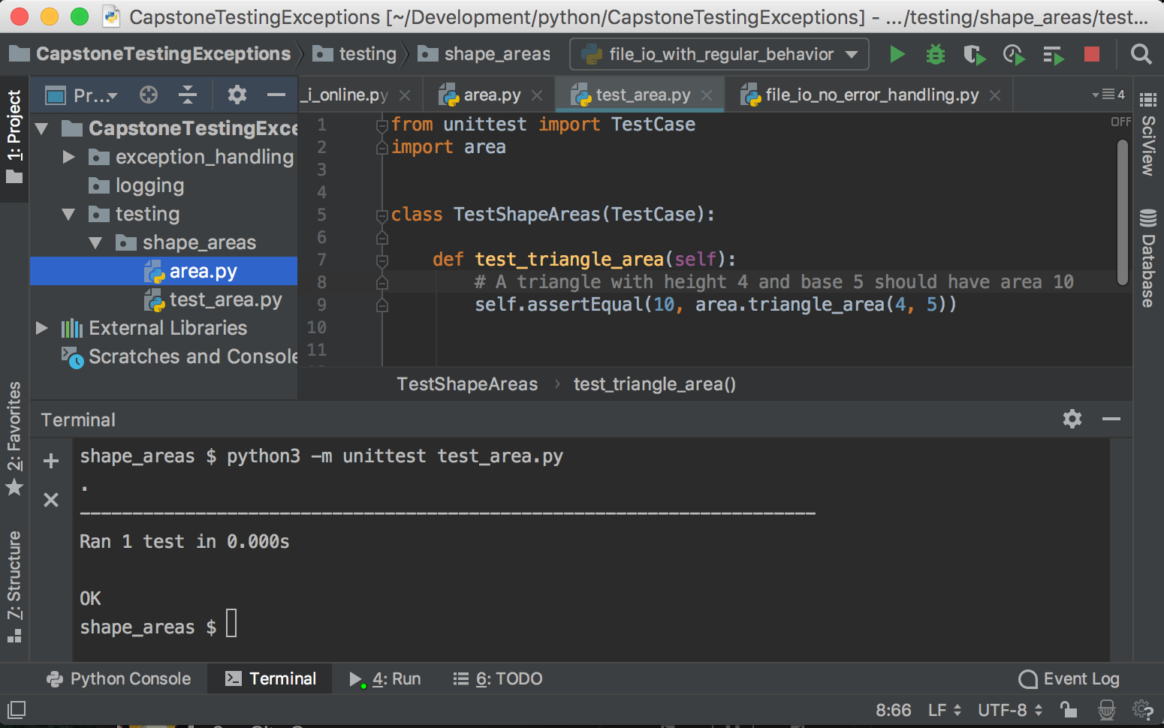
Terminal/Console/Command Prompt
PyCharm modifies the Python Path when running your code so you'll see different behavior running from PyCharm vs. terminal
All of the instructions will use terminal commands
If you are using PyCharm, you can open a terminal window from PyCharm.
Click on the Terminal icon, lower left

Slide 33
Test with a variety of expected data
Good practice to test with a variety of data
What about floating point numbers?
What about negative numbers?
What about 0 values?

Slide 34
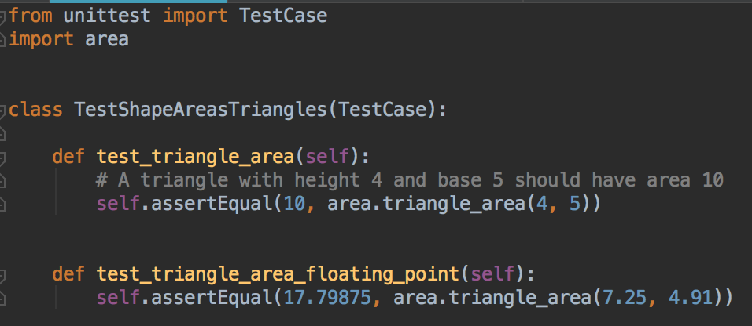
Test with floating point numbers
Add another test method to test_area.py

Slide 35
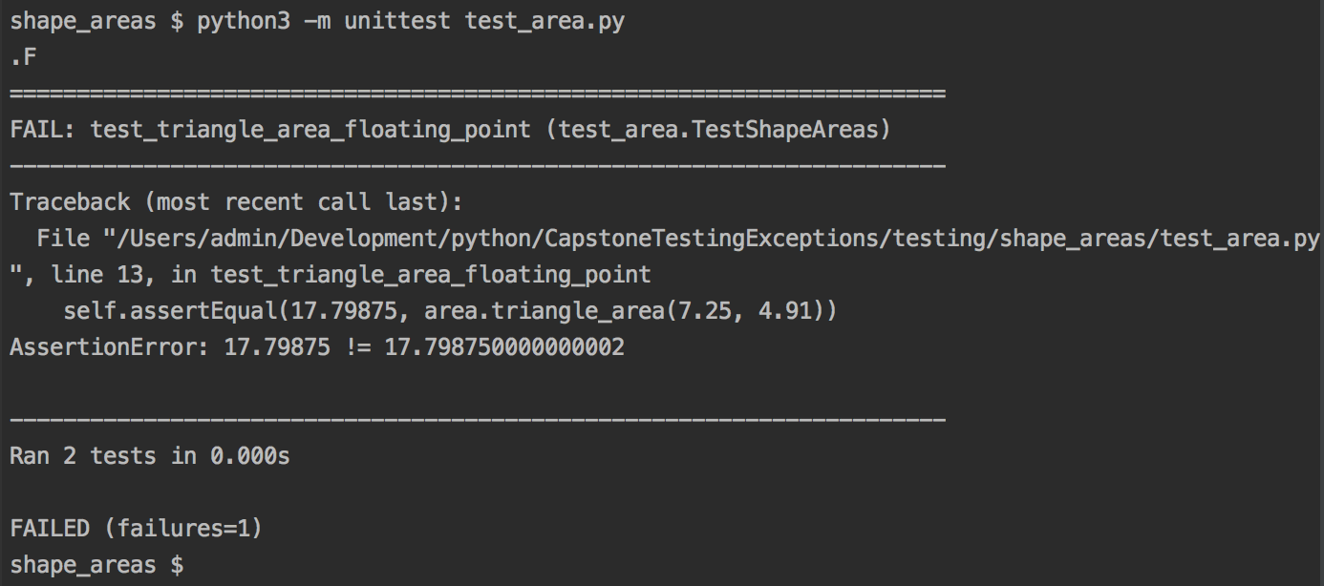
Run tests as before
python -m unittest test_area.py (pc)
python3 -m unittest test_area.py (mac)
Test failure!
Or maybe it will pass on your computer… floating point math is
somewhat architecture-dependent

Slide 36
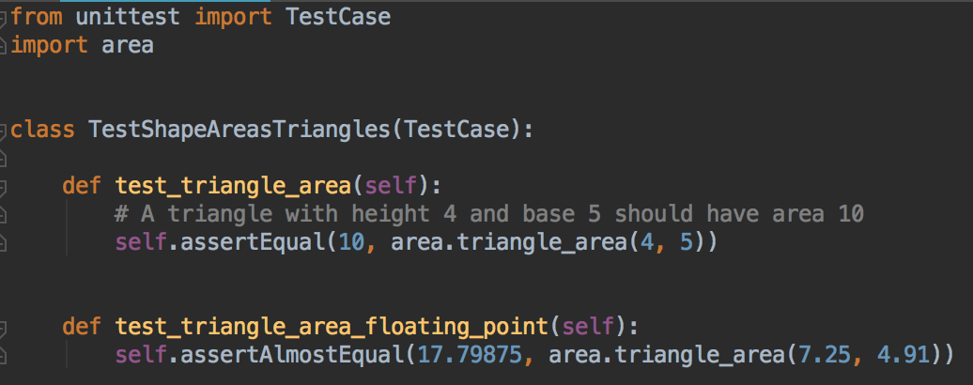
Floating point math tests
Replace with assertAlmostEqual, which rounds the numbers sensibly and then compares
Run tests again - do they pass?

Slide 37
Negative numbers
Problem: what should our function do with negative base or height numbers?
Calculate a negative area?
Raise an exception?
Return 0?
Something else?
Before writing tests, make sure you know what your function should do
Consult the specifications, the customer, your team leader… as appropriate; and clarify what the behavior of the function should be

Slide 38
Let's check the specifications...
Let's say that you checked the specifications, and they require this function to raise a ValueError if the base, or height, or both, are negative
Zero is a valid value for base or height or both, and should return 0 area. No ValueError should be raised

Slide 39
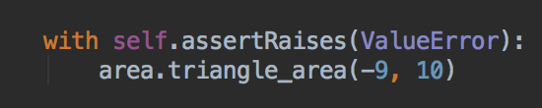
Let's check the specifications...
How to test if an exception is raised?
Can assert that something raises an error
Need to use a context manager
with context manager. This says be prepared to catch an exception, run the triangle_area function, and catch the ValueError if one is raised, instead of letting it crash the program.
The test fails if an ValueError exception is NOT raised.
If a different exception is raised, test fails.
Let's write a test using this (next slide)

Slide 40
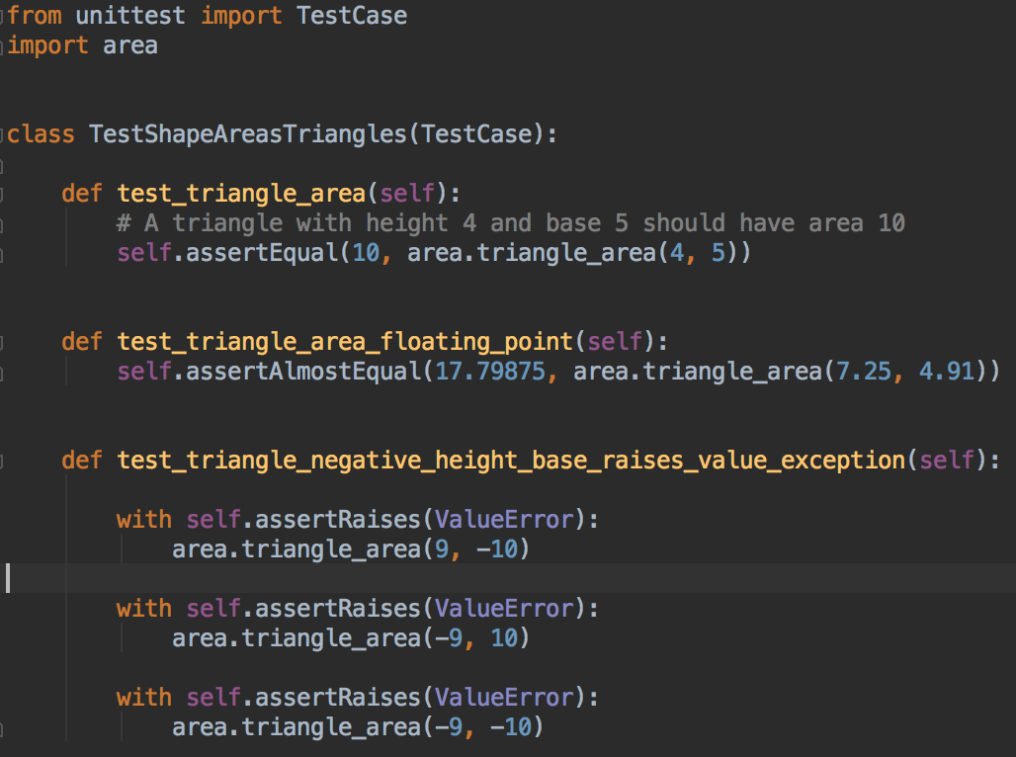
A new test method.
Verbose names are good, they self-document, and they are printed on test failures.

Slide 41
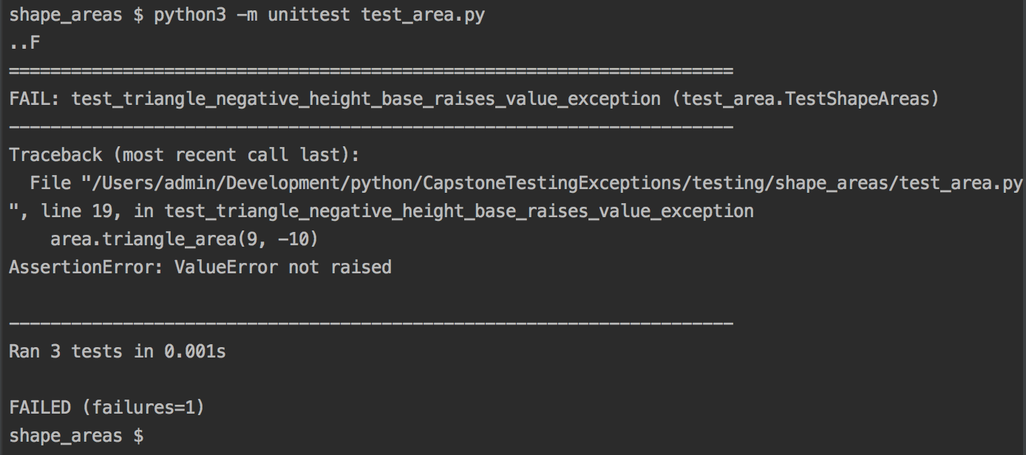
Run tests
Fail… although that was expected

Slide 42
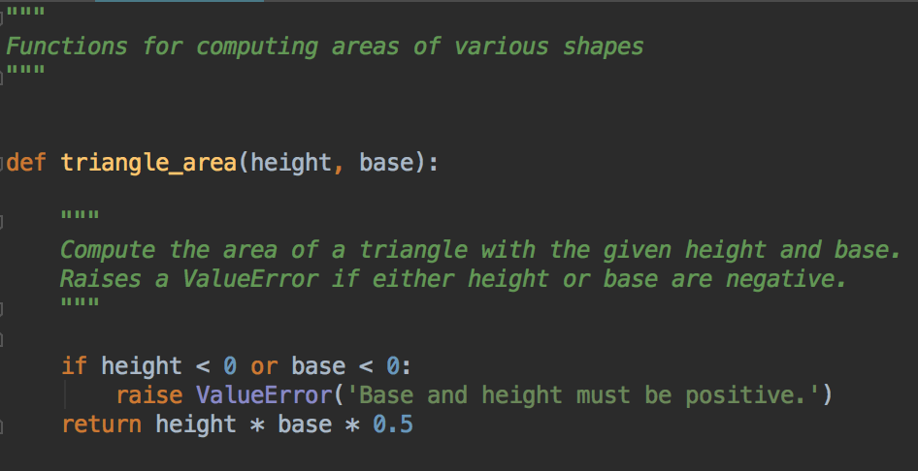
Fix the code to meet the specifications
And some documentation :)

Slide 43
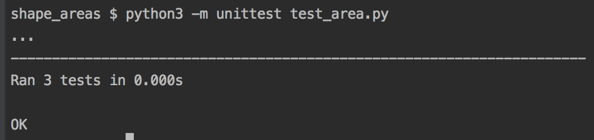
Run tests again…
All three tests should pass
Each dot represents a test pass. Tests can be time consuming so this is a basic progress monitor

Slide 44
Your Turn: Base or height of 0?
Specifications say that base = 0 and/or height = 0 are valid, and will return an area of 0
Your turn: write a new test for either base = 0 , height = 0 and base and height = 0
You should have three assert statements
Use a descriptive name
Does your code pass the tests?
It's important to test edge cases
For example, empty strings, empty lists, 0

Slide 45
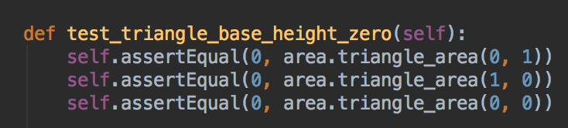
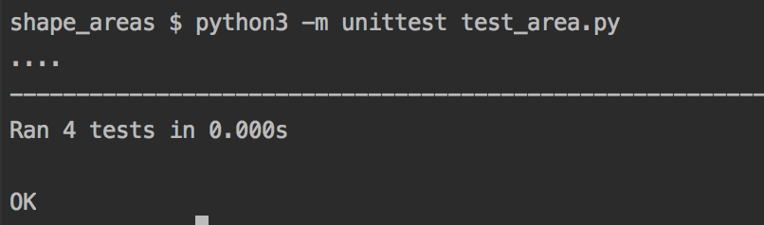
Base and/or height zero
Example test
Make sure all four tests run and pass

Slide 46
Can add more functions to your test
Each function in your test class should test one aspect of the class being tested
Your test functions should begin with test…
unittest looks for function names that begin with test…, and only runs those
So you can add helper functions with other names
For a larger program, you will create separate modules for testing different parts of your program

Slide 47
Remember to verify that of your tests ran
If the test runner reports that it ran 0 tests, and result is OK….
Is that OK?
Things to check: your test class extends unittest.TestCase
Your method names start with test….

Slide 48
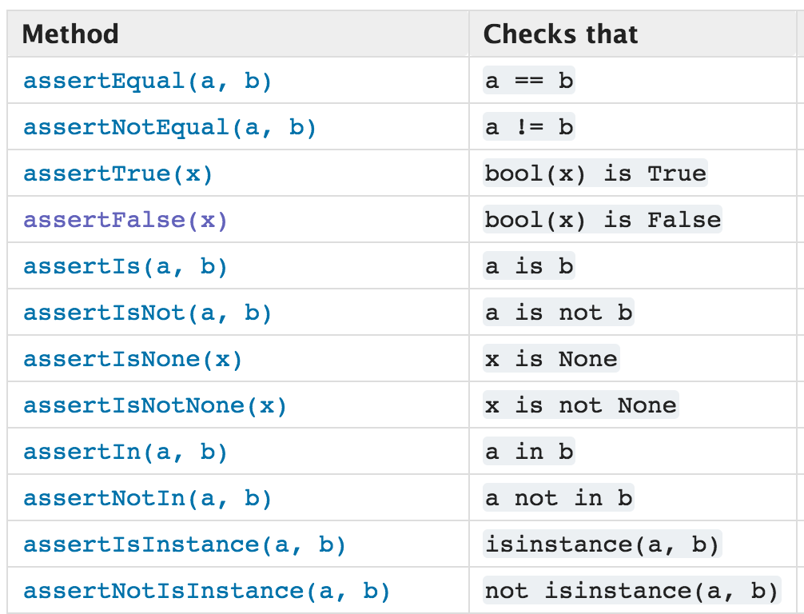
More assertion methods
Read the Python unittest documentation
https://docs.python.org/3.5/library/unittest.html#module-unittest

Slide 49
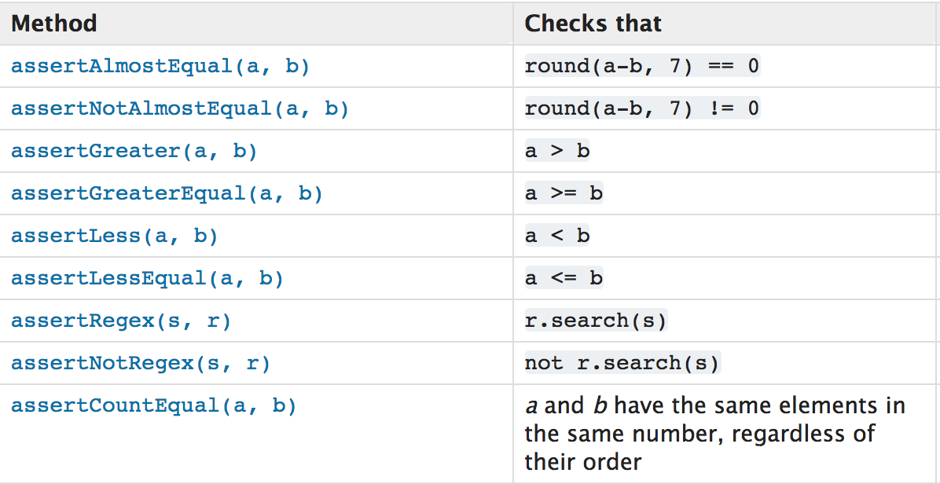
More assertion methods
Read the Python unittest documentation
https://docs.python.org/3.5/library/unittest.html#module-unittest
note that assertCountEqual checks if two things (lists, strings) have the same elements in any order, despite the name

Slide 50
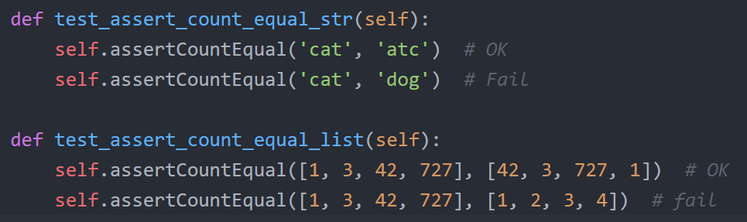
assertCountEqual
This function name is not very descriptive
It actually checks if two sequences have the same elements, in any order
Examples:

Slide 51
Test-Driven Development
Instead of thinking about coding and then testing,
Write the tests that the code must pass, then write code that will pass that test
Pure TDD is not that common; more often used in sections of some projects
We did some TDD with the Triangle example
BUT automated testing is helpful for almost all projects

Slide 52
Bug Driven Testing
"Pursue another very impactful testing practice: whenever a bug is reported [or you find a bug] in your application, write a test to verify the bug. Then fix your application until the bug goes away [and the test passes]. By doing things that way, you end up with a collection of tests that reflect the various ways that the users of your application actually, you know, use your application."
https://www.littlehart.net/atthekeyboard/2012/05/16/test-all-the-things/
So when a bug is discovered, write a test for that part of code, that currently fails, but will pass when the bug was fixed. Then fix the code so the test passes.

Slide 53
Testing Concerns
Remember that we wrote the test, so testing depends on writing the right test
You should also verify that the test is checking the correct thing
Independently calculate what a function should do, and test that
Testing often done in teams: more people develop and review each test

Slide 54
Why write tests?
"Good test methods are short and test only one specific aspect of the class under test."
"You might think that writing unit tests is not useful. After all, we can just look at the code… to see whether they work. But it's easy to have bugs, and JUnit will catch them better than our own eyes.
Even if we already know that the code works, unit testing can still prove useful. Sometimes we introduce a bug when adding new features or changing existing code; something that used to work is now broken. This is called a regression. If we have JUnit tests over the old code, we can make sure that they still pass and avoid costly regressions."
-- http://courses.cs.washington.edu/courses/cse143/11wi/eclipse-tutorial/junit.shtml on JUnit, the most popular Java test framework. Principle applies to every language.

Slide 55
"[I]t's important to ask the question, "Why is testing a valuable use of my time?" It's a fair question, and it's the question those unfamiliar with testing code often ask. After all, testing takes time that could otherwise be spend writing code, and isn't that the most productive thing to be doing?"
"Testing makes sure your code works properly under a given set of conditions
Testing assures correctness under a basic set of conditions. Syntax errors will almost certainly be caught by running tests, and the basic logic of a unit of code can be tested to ensure correctness under certain conditions. Again, it's not about proving the code is correct under any set of conditions. We're simply aiming for a reasonably complete set of possible conditions (i.e. you may write a test for what happens when you call my_addition_function(3, 'refrigerator), but you needn't test all possible strings for each argument).
Testing allows one to ensure that changes to the code did not break existing functionality
This is especially helpful when refactoring code. Without tests in place, you have no assurances that your code changes did not break things that were previously working fine. If you want to be able to change or rewrite your code and know you didn't break anything, proper unit testing is imperative.
Testing forces one to think about the code under unusual conditions, possibly revealing logical errors
Writing tests forces you to think about the non-normal conditions your code may encounter. In the example above, my_addition_function adds two numbers. A simple test of basic correctness would call my_addition_function(2, 2) and assert that the result was 4. Further tests, however, might test that the function works correctly with floats by running my_addition_function(2.0, 2.0). Defensive coding principles suggest that your code should be able to gracefully fail on invalid input, so testing that an exception is properly raised when strings are passed as arguments to the function.
Good testing requires modular, decoupled code, which is a hallmark of good system design
The whole practice of unit testing is made much easier by code that is loosely coupled. If your application code has direct database calls, for example, testing the logic of your application depends on having a valid database connection available and test data to be present in the database. Code that isolates external resources, on the other hand, can easily replace them during testing using mock objects. Applications designed with test-ability in mind usually end up being modular and loosely coupled out of necessity."
https://www.jeffknupp.com/blog/2013/12/09/improve-your-python-understanding-unit-testing/

Slide 56
Modular code
Modular, loosely coupled code
Focused modules, functions
Minimal dependencies on other code
Good design, and makes testing easier too

Slide 57
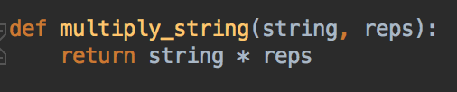

Question
Why did your other programming classes stress writing code in functions/methods instead of one big block?
Why is it better for a function to return data, than it is to print the answer?
Which one of these would be easier to test?

Slide 58
Interview Questions
Sample interview questions
"Can you explain what is meant by test-driven development"
"Have you used any unit testing frameworks?"
"Can you tell me the advantages of unit testing?"
"Can you explain the steps of creating and using a unit test?"

Slide 59
Test Coverage
Test coverage is the % of code for which there is a unit test
Tools like coverage.py can calculate this
https://docs.python.org/devguide/coverage.html
https://coverage.readthedocs.io/en/coverage-4.3.4/
Test coverage measurements have no inherent correlation to the tests being appropriate, that the tests are testing the right thing…
Instead of aiming for 100% coverage, it's better to focus on testing the most complex parts of your program; the parts that are most likely to have errors, or go wrong
Write code to contain individual complex tasks in specific functions that you can write tests for

Slide 60
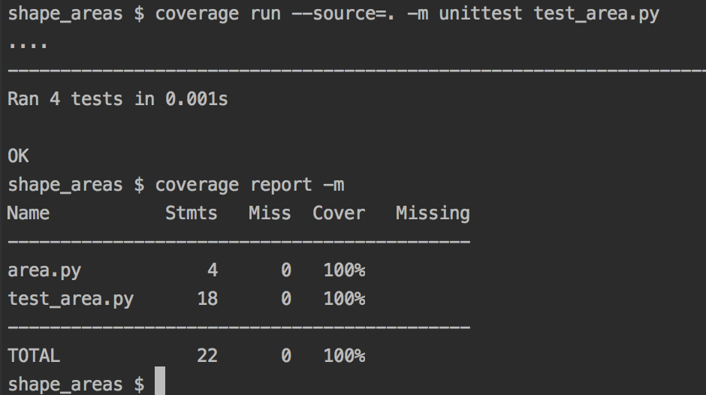
Test Coverage https://coverage.readthedocs.io/en/coverage-4.3.4/
Install with
pip install coverage (PC)
pip3 install coverage (Mac)
Run coverage and generate report
coverage run --source=. -m unittest test_area.py
coverage report -m
Lab PCs, this probably won’t work – coverage script is not added to your path

Slide 61
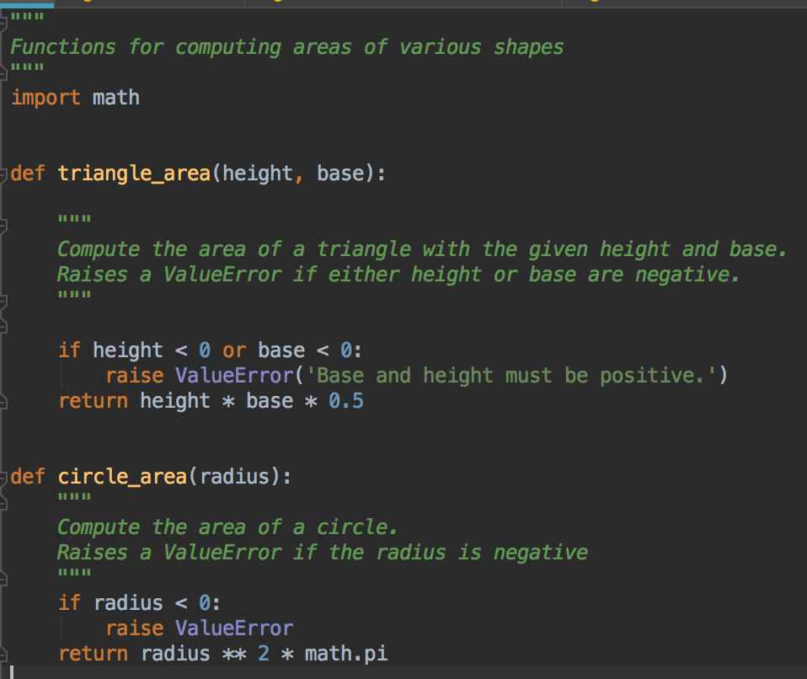
So if we add more code

Slide 62
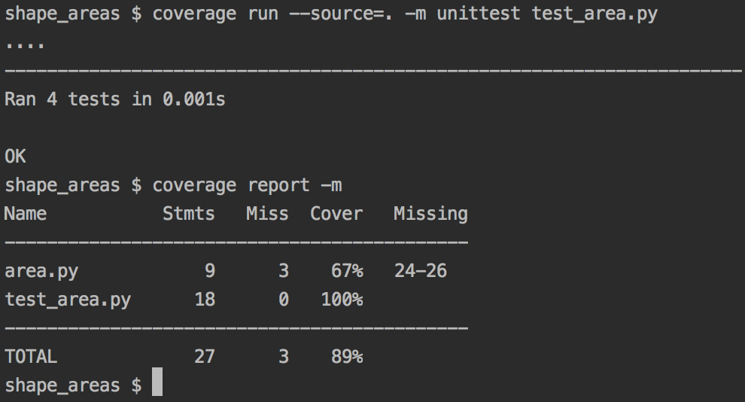
Test coverage
Same commands as before, code that is not run as part of the unit tests is reported

Slide 63
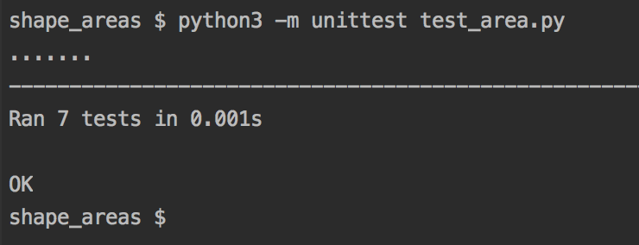
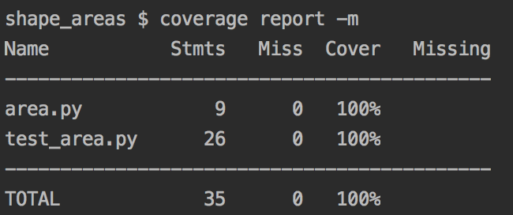
Add some tests for circle_area
Create a new test class called TestShapeAreasCircles
Again, this is a subclass of TestCase
1. In this class, write a test for example area calculation with a positive radius
You'll need to use assertAlmostEqual
Use a calculator to figure out the expected value for an example radius
2. Write a test for zero area if radius is 0
3. Write a test for ValueError raised if radius is negative
Should now have seven passing tests
If you can run coverage, check it's at 100% again

Slide 64
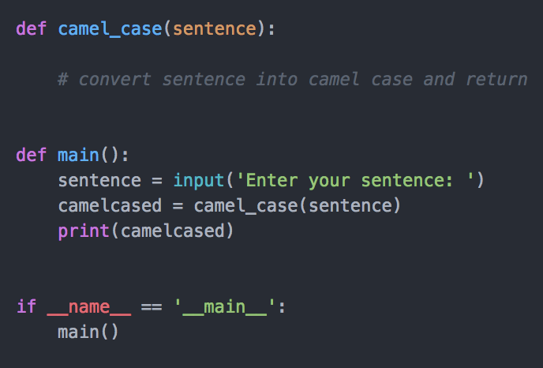
Tests for camelCase program
Your turn
Start with your camelCase program – Lab 1
If you don't have functions already, re-write it so it's in this format
Why? Separate the input/output from the camelcasing code

Slide 65
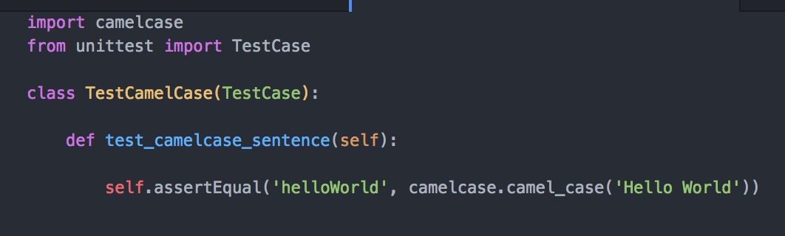
Create new test file
Same directory as your camelcase.py file
Call it test_camelcase.py
Replace camelcase with the name of your code file, if different

Slide 66
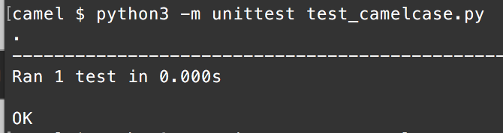
Test
python or python3, depending on PC or Mac

Slide 67
Can you add to this test?
What about a blank sentence or empty string
One word
What about strings with numbers, or punctuation
Unicode characters, or emojis
Strings that contain newlines or tab characters
Strings with whitespace at the start or end
More than one space between words
What else should you cover?
Did you find any bugs?

Slide 68
But that input can’t happen…
Just because you can’t call your function with a string with \n in your camelCase program,
It doesn’t guarantee that other part of your code won’t call the function with ‘\n’
Still test for all different kinds of data, even if you think it’s impossible for your function to be called with that data
Because someday, your function may be used in a different way

Slide 69
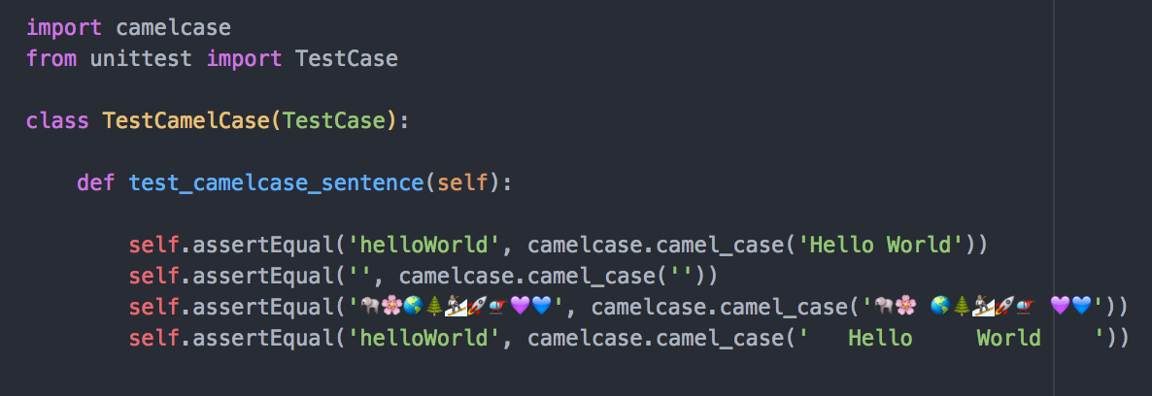
A couple more tests
What tests did you add?
There's no uppercase/lowercase version of emjois.

Slide 70
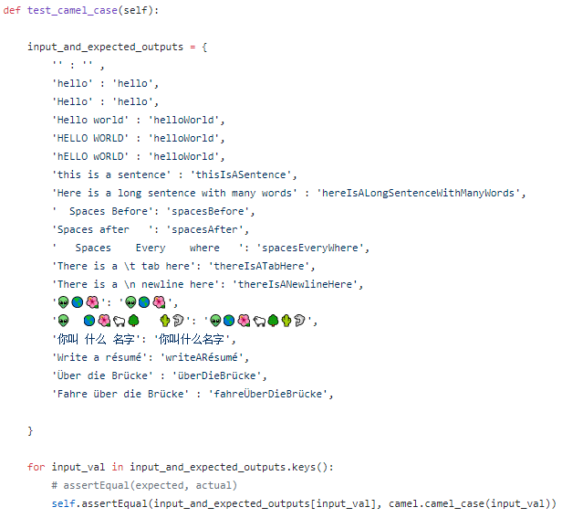
Managing many inputs and outputs
Example: use a dictionary to save many inputs and expected outputs, then loop and try them all
Saves some typing

Slide 71
How easy was your program to test?
Did you have to re-write it to isolate the camelCase logic?
As you work on programs, think about how to write code that can be tested
Small functions, minimal dependencies, have input and output instead of printing

Slide 72
Another example, more assert methods
assertTrue
assertFalse
assertIsNone, assertIsNotNone
assertIsIn, assertIsNotIn

Slide 73
AAA Test Structure
Arrange
Set up test, create example data
Action
Do the action being tested
Assert
Check the results are as expected

Slide 74
Start with this code
https://github.com/claraj/hello_python_unittest and open the code in the student_lists directory
Student class list manager application
studentlists.py: main code
test_studentlists.py: tests

Slide 75
Can you finish the tests?
Look for the TODO markers
Let's do a couple together

Slide 76
More practice
The cellphones directory also has a program with partial complete tests - can you finish those?

Slide 77
Summary
All software developers need to be able to write tests
And before you can write tests, you must write testable code
Modular
Composed of functions; each with one specific, defined purpose
Minimize dependencies within a function

